Slide 1
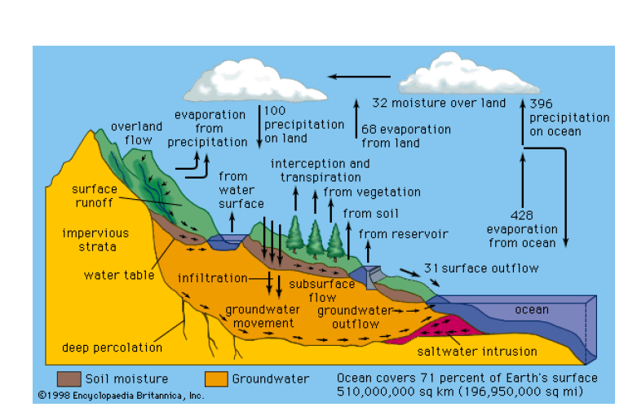
Unit-III
Water
Technology

Slide 2
Types of impurities in water
Organic Impurities: Organic impurities are decaying plant and animal matter. These impurities give water an unpleasant taste and odor.
Inorganic Impurities: These impurities include dissolved minerals, heavy metals ,pesticides, industrial pollutants, and pharmaceuticals.
Physical Impurities: These impurities include sediment, sand, rust, and debris, which affect water clarity and taste.
Total Dissolved Solids (TDS):TDS refers to the total concentration of dissolved minerals and salts in water. High TDS levels can lead to water that tastes salty or bitter.
Biological Impurities: Biological impurities include bacteria, viruses, and parasites. Consuming such water can lead to waterborne diseases.

Slide 3
Difference between hard water and soft water
Hard Water | Soft Water
Hard water does not lather with soap but instead forms a precipitate. | Soft water lather with soap.
Hard water doesn't form lather or foam with soap. | Soft water forms lather and foam with soap.
Soap is not effective against hard water. | Soap is effective against soft water.
Hard water has a characteristic taste and isn’t suitable for heavy machinery, boilers, and other appliances. | Soft water is known to have a salty taste and is widely suitable for machinery, boilers, etc.
Hard water is rich in minerals. Hence it mainly contains minerals such as magnesium and calcium. | Soft water is not rich in minerals. It mainly contains sodium ions.
Example: Water found in wells, groundwater | Example: rainwater

Slide 4
The hardness of water
The total amount of dissolved calcium and magnesium salts present in the water is called hardness water.
Causes of hardness of water:
The presence of bicarbonates, chlorides, and the sulphates of calcium and magnesium in water causes the hardness of water.
Cations Ca²⁺ and Mg²⁺ present in hard water react with soap (sodium stearate) to form insoluble precipitates (calcium or magnesium stearate).
Lather will not be produced until all the calcium and magnesium ions are precipitated. Thus, it hinders the cleansing action of soap.
This also results in the wastage of a quantity of soap.
2C₁₇H₃₅COONa + CaCl₂ → (C₁₇H₃₅COO)₂Ca ↓ +2NaCl
Calcium Stearate
2C₁₇H₃₅COONa + MgSO₄→(C₁₇H₃₅COO)₂Mg↓ +Na₂SO₄
Magnesium Stearate

Slide 5
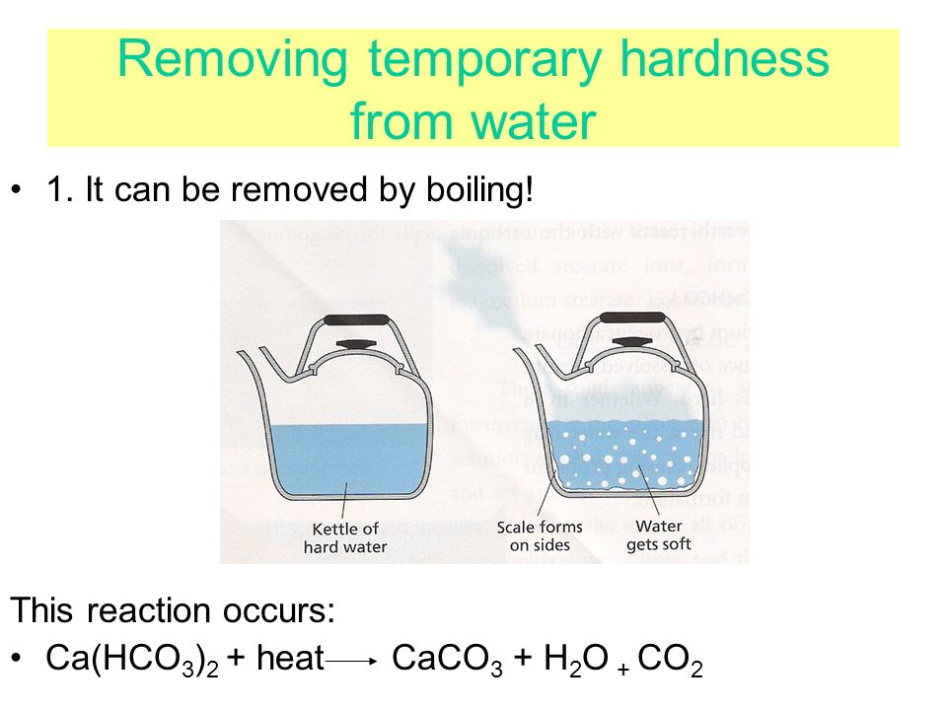
Types of Hardness
Temporary hardness:
It is caused by the presence of dissolved bicarbonates of calcium and magnesium and carbonates of Iron.
Temporary hardness is easily removed by boiling, on boiling bicarbonates are decomposed into insoluble carbonates or hydroxides.
Ca (HCO₃)₂ → CaCO₃↓ + H₂O + CO₂↑
Mg (HCO₃)₂ → Mg (OH) ₂ ↓+ 2CO₂↑
It is also known as carbonate hardness.

Slide 6
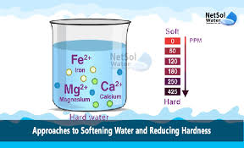
Permanent hardness
It is caused by the presence of dissolved chlorides, and sulphates of the calcium and magnesium and iron.
The dissolved salts are CaCl₂, MgCl₂, CaSO₄, MgSO₄, FeSO₄, Al₂(SO₄)₃ etc.
Unlike temporary hardness, permanent hardness is not destroyed on boiling.
It is also known as non carbonate hardness.

Slide 7
Degree of Hardness
The hardness of water is expressed in terms of calcium carbonate equivalents.
The weights of different salts that causing hardness are converted to weight equivalent to that of calcium carbonate.
The reason for choosing CaCO₃ as standard for reporting hardness is ease in calculations as its molecular weight is exactly 100 and is insoluble in water.
Hardness causing salt and molecular weight
Ca(HCO₃)₂ = 162
Mg(HCO₃)₂ = 146
CaSO₄ = 136
MgSO₄ =120
CaCl₂ = 110
MgCl₂ = 95
CaCO₃ =100

Slide 8
Units for Hardness
Parts per million(ppm):-The number of parts by weight of CaCO₃ present per million (10⁶) parts by weight of water.
1ppm = 1 part of CaCO₃ equivalents in 10⁶ parts of water.
Degree Clarke(ºCl):- Parts of CaCO₃ equivalents of hardness per 70.000 parts of water.
1ºCl = 1 part of CaCO₃ per 70,000 parts of water.
Degree French(⁰Fr):- The parts of CaCO₃ equivalents of hardness per 10⁵ parts of water.
1ºFr = 1 part of CaCO₃ per 10⁵ parts of water.
Milligram per litre
1 mg/lit = 1 mg of CaCO3 present in 1 lit of water
Relationship between units:
1 mg/lit = 1ppm = 0.07ºCl = 0.1ºFr

Slide 9
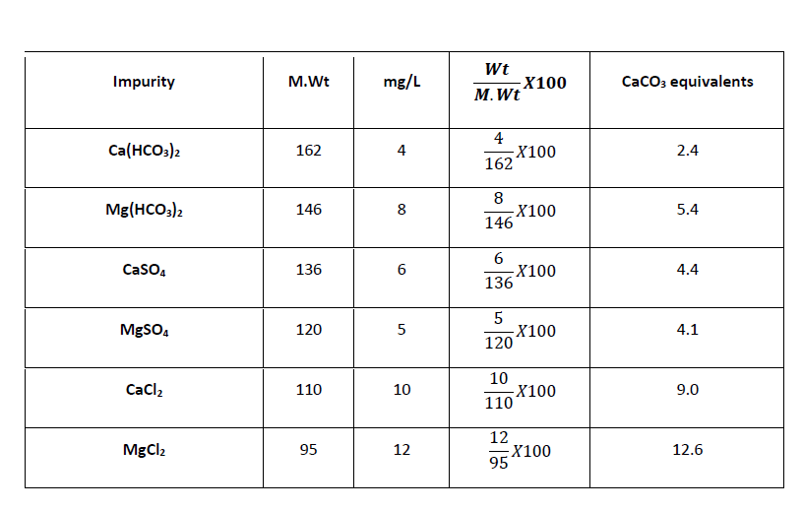
A water sample on analysis is found to contain the following impurities. Calculate the temporary, permanent and total hardness of water in mg, ppm, ºFr and ºCl.
Impurity | Ca(HCO₃)₂ | Mg(HCO₃) | CaSO₄ | MgSO₄ | CaCl₂ | MgCl₂
weight | 4 | 8 | 6 | 5 | 10 | 12
Molecular weight | 162 | 146 | 136 | 120 | 110 | 95
Solution
Ca (HCO₃)₂ and Mg (HCO₃)₂ cause temporary hardness
2.4 + 5.4=7.8 mg or ppm
7.8X0.07 = 0.546 ºCl
7.8 x 0.1 = 0.78 ºFr
CaSO₄, MgSO₄, CaCl₂, and MgCl2, cause permanent hardness
4.4 + 4.1 + 9.0 + 12.6 = 30.1 mg (or) ppm
30.1 X 0.07 = 2.1 ºCl
30.1 X 0.1 = 3.01 ºFr
Total hardness = Temporary hardness + Permanent hardness
7.8 + 30.1 = 37.9 mg (or) ppm
37.9X 0.07 =2.65 ºCl
37.9 X 0.1 = 3.79 ºFr

Slide 10
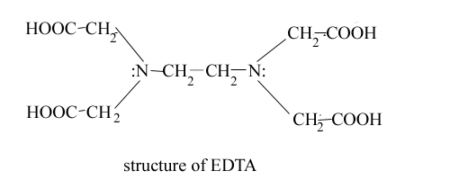
ESTIMATION OF HARDNESS OF WATER BY COMPLEXOMETRIC METHOD
PRINCIPLE:
The capacity of water to precipitate soap (prevent lather) is the hardness. It is caused by dissolved calcium and magnesium salts. Bicarbonates cause temporary hardness and chlorides and sulphates permanent hardness.
Ethylene diamine tetra acetic acid (EDTA) is a complexing agent, hexa-dentate ligand and forms complexes with Ca²⁺, Mg²⁺ ions. Hence the titration is complexometric titration. Eriochrome Black-T is the indicator and is blue in colour in Free State.

Slide 11
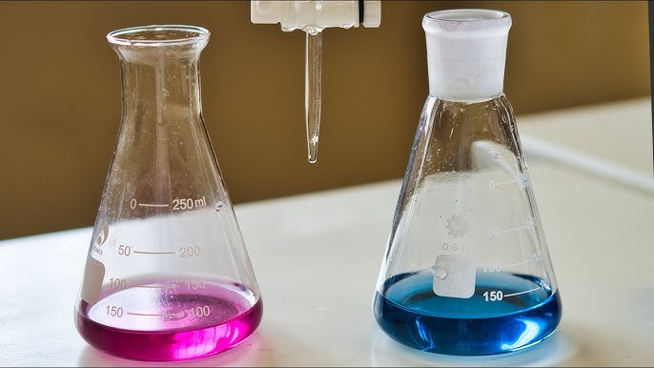
When EBT is added to the hard water at p^{H} = 10, it gives wine-red colored unstable complexes with Ca²⁺ and Mg²⁺ ions. The solution turns blue when this mixture is titrated against EDTA solution.

Slide 12
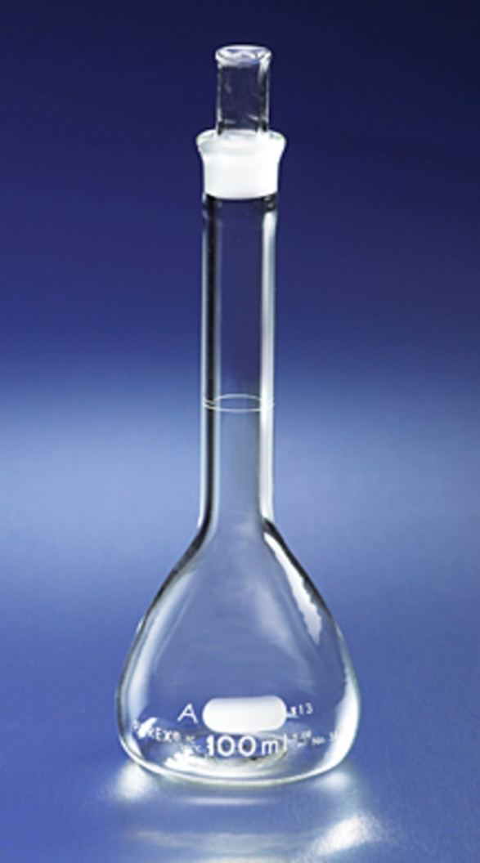

PROCEDURE
Part-1
Preparation of standard hard water
Take 0.1 grams of Epsom salt and transfer it into a 100 ml. standard flask. Add few ml. of water and shake properly to get clear solution. Make up the solution up to the mark of the standard flask by adding distilled water.
Normality (N₁) =
Where
Normality of standard hard water (N₁) =
Volume of distilled water (V_{ml}) = 100 ml.
Weight of Epsom Salt = 0.1 gm
Equivalent weight of Epsom Salt = 123

Slide 13
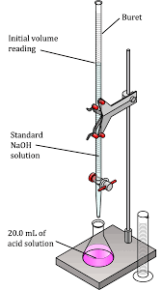
Part-2
Standardization of EDTA
Pipette out 10ml. of Standard hard water into a conical flask. Add 5ml (approx.) of buffer solution and 2 to 3 drops of Eriochrome black-T indicator. The solution attains wine-red colour. Titrate the contents of the conical flask against the EDTA solution until the colour changes to blue. Note the burette reading and repeat the titration to get concurrent values.
N₁V₁ (Standard hard water) = N₂V₂ (EDTA)
Normality of standard hard water (N₁) =
Volume of standard hard water (V₁) = 10 ml.
Normality of EDTA (N₂) =?
Volume of EDTA used in 2nd step (V₂) =?

Slide 14
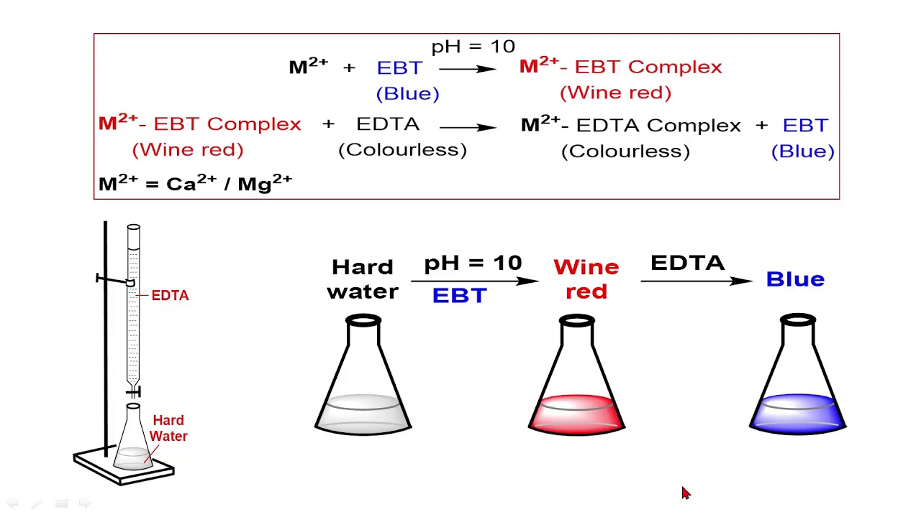
Part-3
Determination of total hardness of test sample of water
Pipette out 10ml. of test water sample into the conical flask. Add 5ml (approx) of buffer and 2 to 3 drops of Eriochrome Black-T indicator. The solution attains wine-red colour. Titrate the contents of the conical flask against EDTA solution till the colour changes from wine-red to blue. Note the burette reading and repeat the titration to get concurrent values.
N₂V₂ (EDTA) = N₃V₃ (Test water sample)
Normality of test water sample (N₃) =
Volume of test water sample (V₃) = 10 ml.
Normality of EDTA (N₂) =?
Volume of EDTA used in 3rd step (V₂) =?
The total hardness of the test sample of water is calculated as follows
Total hardness = N₃ × 50 × 1000 = ----- mg/lit or ppm.
The total hardness of water is ------------ mg/lit or ppm.

Slide 15
Part-4
Determination of Permanent hardness of test sample of water
Take 50ml of water in beaker , boil for 10 minutes and filter the water. Pipette out 10ml. of boiled test water sample into the conical flask. Add 5ml (approx) of buffer and 2 to 3 drops of Eriochrome Black-T indicator. The solution attains wine-red colour. Titrate the contents of the conical flask against EDTA solution till the colour changes from wine-red to blue. Note the burette reading and repeat the titration to get concurrent values.
N₂V₂ (EDTA) = N₄V₄ (boiled Test water sample)
Normality of boiled test water sample (N₄) =
Volume of boiled test water sample (V₄) = 10 ml.
Normality of EDTA (N₂) =?
Volume of EDTA used in 4th step (V₂) =?
The permanent hardness of the test sample of water is calculated as follows
Permanent hardness = N₄ × 50 × 1000 = ----- mg/lit or ppm.
The total hardness = Permanent hardness + Temporary hardness.
Temporary hardness = The total hardness - Permanent hardness

Slide 16

1.0 gm of Epsom salt was dissolved in 100 ml of distilled water. 50 ml of this solution required 45 ml of EDTA solution for titration. 50 ml of test hard water sample required 28 ml of EDTA and after boiling and filtering required 15 ml of EDTA solution. Calculate the total hardness, permanent hardness and temporary hardness of water.
Normality of St.HW (N₁) =
=
N₁V₁ (St. HW) = N₂V₂ (EDTA) = 0.08 × 50 = N₂ × 45, N₂ = 0.088N
N₂V₂ (EDTA) = N₃V₃ (TWS) = 0.088 × 28 = N₃ × 50, N₃ = 0.049N
Total hardness = N₃ × 50 × 1000 = 0.049 × 50 × 1000 = 2450 mg/lit (or) ppm.
N₂V₂ (EDTA) = N₄V₄ (boiled TWS) = 0.088 × 15 = N₄ × 50 = 0.026N
Permanent hardness = N₄ × 50 × 1000 = 0.026 × 50 × 1000= 1300 mg/lit (or) ppm.
The total hardness = Permanent hardness + Temporary hardness.
Temporary hardness = The total hardness - Permanent hardness = 2450- 1300 = 1150 mg/ lit (or) ppm

Slide 17

Standards of water used in various industries
Food Industry
It must be free from undesirable taste, odor, color, and impurities.
If organic matter present is source for pathogens such as viruses, protozoa and bacteria.
Deficiency of fluoride causes tooth decay.. However, excess fluoride causes mottling of teeth and bone defects.
Excess lead has certain neurological effects. Long-term exposure can damage the liver, kidney, etc.
Nitrates are used in fertilizers. They can reach surface and groundwater. If the concentration of nitrates exceeds 50 ppm in water, it causes the blue baby syndrome.
The metals such as iron, copper, aluminum, zinc should in permissible concentration.

Slide 18
Textile industry:
If hard water used, uniform dyeing not possible
Hard water decreases solubility of acidic dyes and Basic dyes precipitated.
Organic matter imparts foul smell
Fe and Mn salts leaves stains on fabrics
Pharmaceutical industries:
Require pure water , should be colorless, tasteless, odourless and free from pathogens.
Hard water, if used for preparing pharmaceutical product like drugs, injections and ointments etc. may produce certain undesirable products in them
Sugar industry:
If hard water is used, results in deliquescent sugar.
Impurities cause difficulty in crystallization.
Paper industry:
Should free from SiO₂, Fe and Mn salts
SiO₂ produces cracks and Fe, Mn imparts colour to paper.

Slide 19
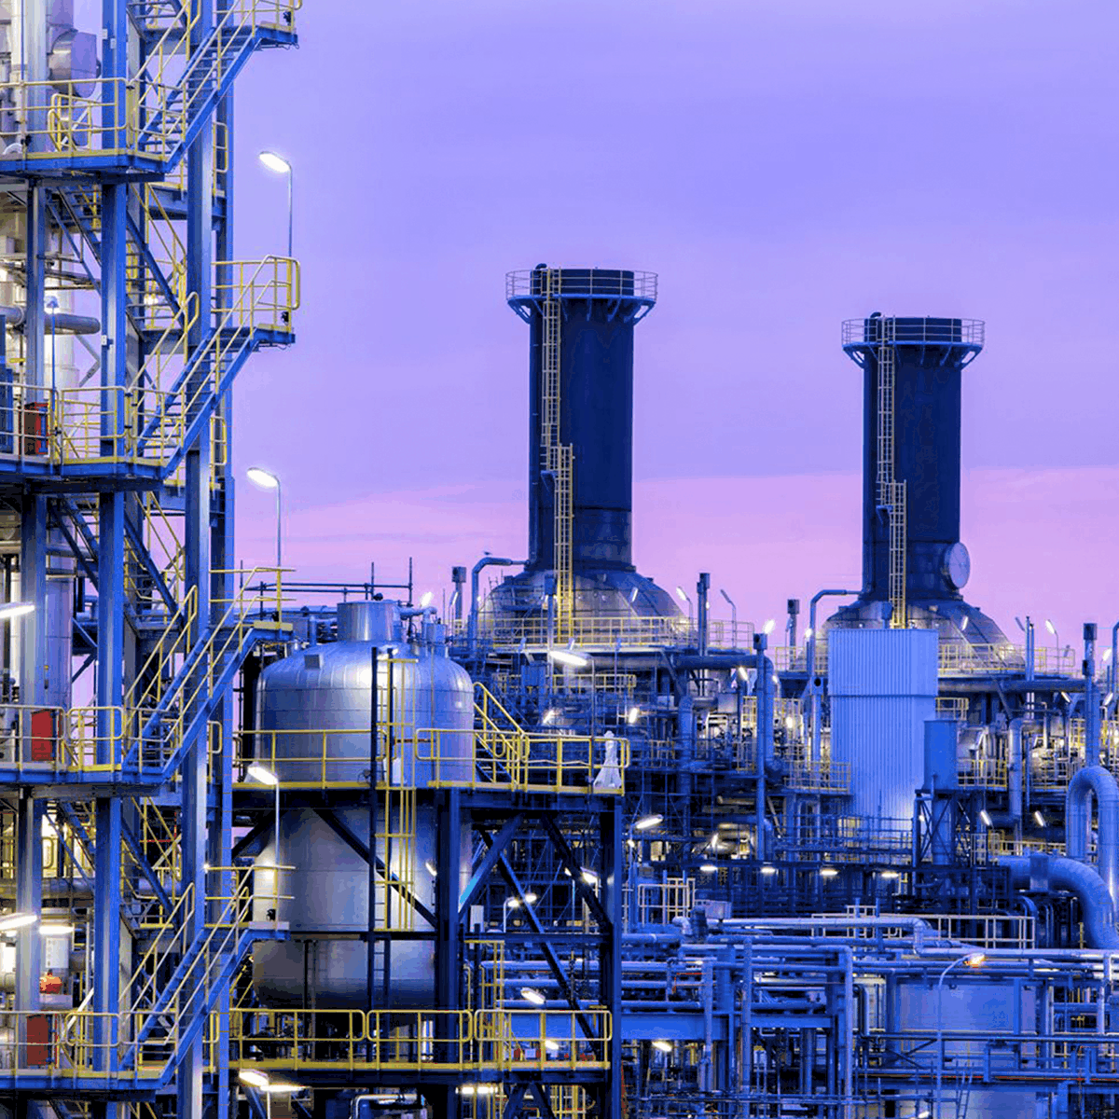
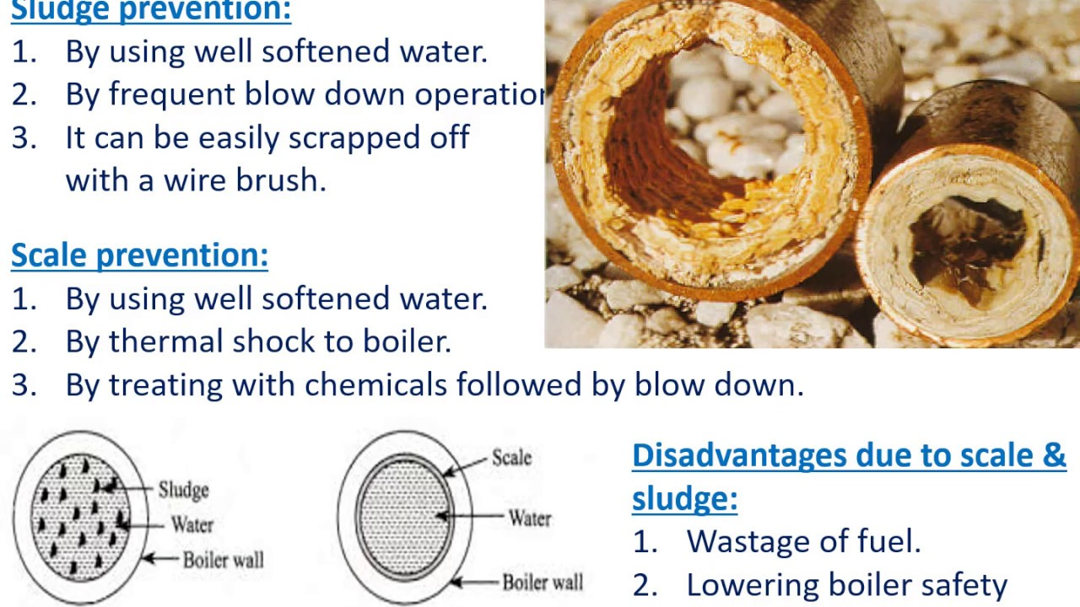
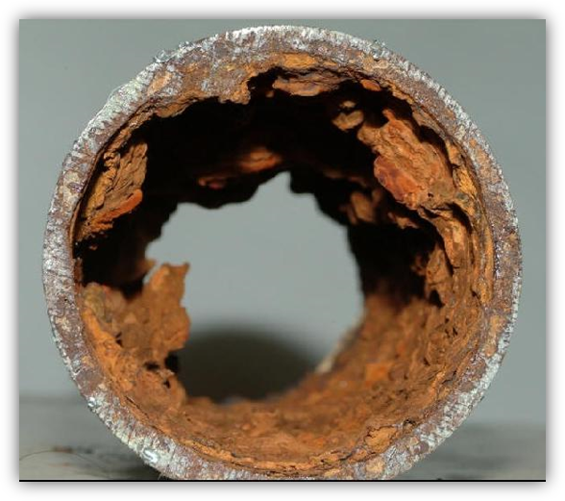
Boiler troubles
Boilers are employed in industries for generation of steam.
When raw water is directly feed into the boilers various physical changes and chemical reactions are induced in the boiler with the action of the heat.
The ultimate result being the problem such as
Carry over,
Boiler corrosion,
Caustic embrittlement and
Sludge and Scale formation.

Slide 20
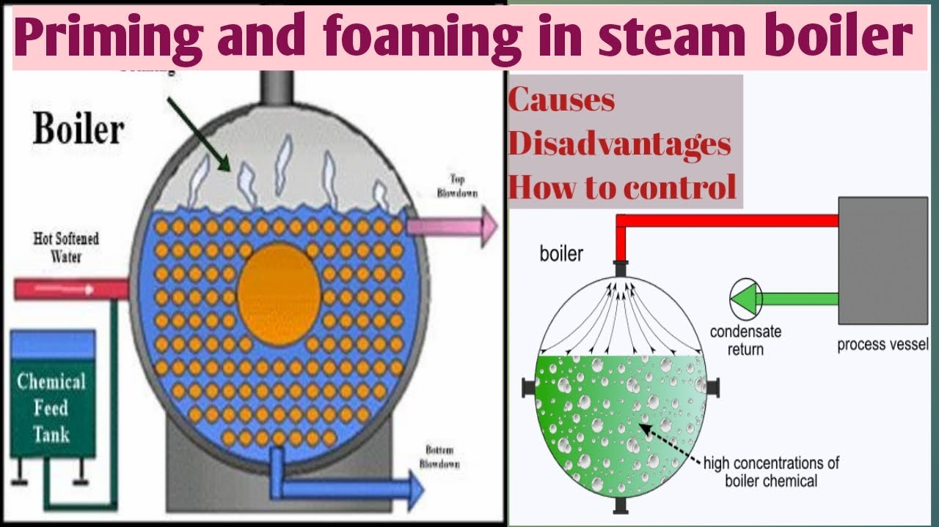
Carryover
Carryover is the carryover of solid, liquid & gaseous contaminants with water and steam leaving the drum due to incomplete separation of water and steam in steam drum. It is in two ways;
Priming
Foaming
Priming:
As the boiler generates steam rapidly, some water particles are carried along with the steam.
The process of formation of wet steam is known as priming.

Slide 21
Causes of Priming:
· Large amount of dissolved solids like alkali sulfates and chlorides present
· Sudden boiling operation
· Inadequate amount of steam space
· Improper design of steam boiler
· Sudden acceleration in steam-production rate
Effects of Priming:
· Reduction in boiler efficiency
· Increase in maintenance costs
· Lowers the lifespan of the machinery parts
Prevention for priming:
· Improved steam boiler design
· Introducing mechanical steam purifiers in boiler systems
· Maintaining low water levels in the boiler
· Utilization of soft water
· Reducing the amount of dissolved salts in the feed water

Slide 22
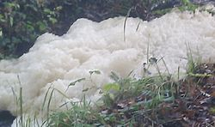
Foaming
Foaming is the formation of unstoppable bubbles or foam in the steam boiler that does not cease easily.
It is caused due to the oily and alkali substances in water that reduce the surface tension in the boiler water.
Oils, alkalis react to form soaps which lower the surface tension of water and increase the foaming.

Slide 23
Causes of Foaming:
High level of dissolved solids in boiler water
Increase in water level
Higher impurities
High presence of chemicals
Effects of Foaming:
The actual height of the water column cannot be accurately estimated, which makes the maintenance of the pressure part challenging.
The dissolved salts in the water passed by the wet steam damages the turbine blades and super heaters, resultantly reducing their efficiency
The dissolved salts in the water may impact the other machinery parts that decrease the overall lifespan of the steam boiler.
Prevention of Foaming:
Introducing anti-foaming agents such as castor oil, tannic acid, Gallic acid, etc.
Administrating compounds like Sodium aluminate and Aluminum sulphate for eliminating oil from the boiler water

Slide 24
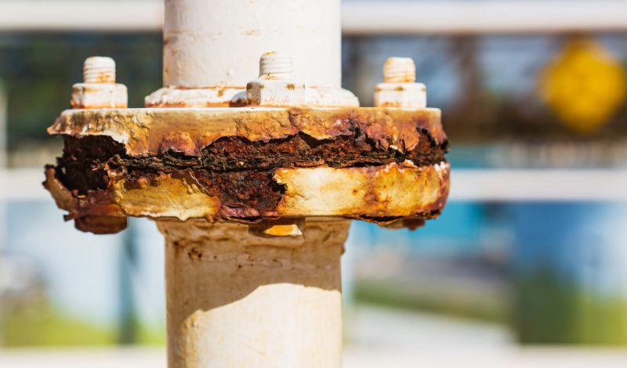
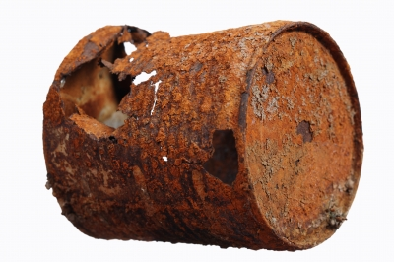
2.Boiler Corrosion
The decay (or) disintegration of boiler material either due to chemical (or) electrochemical reaction with its environment is called boiler corrosion.
Disadvantages of boiler corrosion are:
Shortening of boiler life
Leakages of boiler
Increased cost of repairs
Main sources for boiler corrosion are
Dissolved oxygen
Dissolved carbon dioxide
Acids from dissolved salts

Slide 25
Dissolved oxygen: Water usually contains about 8 ppm of dissolved oxygen at room temp. As the water is heated, the dissolved oxygen is set free and the boiler starts corroding.
4Fe +2H₂O + O → 4Fe [OH] ₂↓
4Fe [OH] ₂↓ + O₂ → 2[Fe₂O₃2H₂O] ↓
(Ferrous hydroxide) (Rust)
Removal of dissolved oxygen:
By adding hydrazine or sodium sulphite or sodium sulphide.
N₂H₄ + O₂ → N₂ + 2H₂O
2Na₂SO₃ + O₂ → 2 Na₂SO₄
Na₂S + 2O₂ → Na₂SO₄
Hydrazine is an ideal chemical for the removal of dissolved oxygen. It reacts with oxygen,
forming nitrogen and water. Nitrogen is harmless.

Slide 26
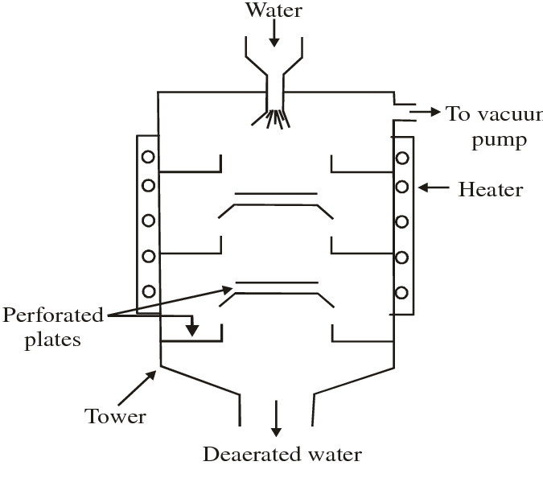
Dissolved carbon dioxide: There are two sources of CO₂ in boiler water, viz. dissolved CO₂ in raw water and CO₂ formed by decomposition of bicarbonates in H₂O according to the equation:
Mg(HCO₃)₂ Mg(OH)₂ + 2CO₂
Carbon dioxide in presence of water forms carbonic acid which has a corrosive effect on the boiler material like any other acid.
H₂O + CO₂ → H₂CO₃
Removal of dissolved CO₂:
By adding ammonia:
NH₄OH + CO₂ (NH₄)₂CO₃ + H₂O
By mechanical de-aeration: This process consists of spraying water over preheated perforated plates stacked in a degasifier. Removal of dissolved O₂ and CO₂ is ensured by applying high temperature and vacuum.

Slide 27
Acids from dissolved salts: Mineral acids are generated by the hydrolysis of dissolved acidic salts. The liberated acid reacts with Fe of boiler to form Fe (OH) ₂ subsequently get converted into rust. Small amount of MgCl₂ will cause corrosion of Fe to a large extent.
MgCl₂ + 2H₂O → Mg (OH) ₂ + 2HCl
2HCl + Fe → FeCl₂ + H₂
FeCl₂ + 2H₂O → Fe (OH) ₂ + 2HCl
Fe (OH) ₂ + O₂ → Fe₂O₃ .2H₂O
As the boiler water is generally alkaline and hence the acid is usually neutralized.
In case the amount of acid is more, calculated quantity of alkali is added from outside to neutralize the acid for preventing this corrosion.
By frequent blow down operation

Slide 28
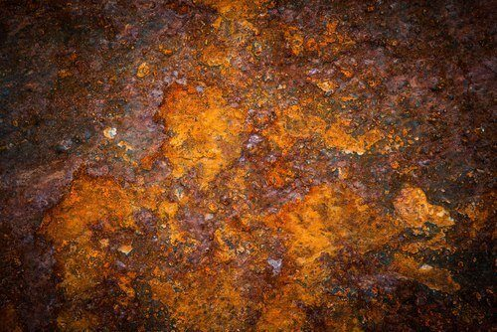
Caustic Embrittlement
This is phenomenon during which the boiler material becomes brittle due to the accumulation of caustic substances.
During softening by lime-soda process, it is likely that some residual Na₂CO₃ is still present in the softened water.
In high pressure boilers Na₂CO₃ decomposes to give sodium hydroxide and CO₂, and sodium hydroxide thus produced makes the boiler water “caustic”.
Na₂CO₃ + H₂O 2NaOH + CO₂
This caustic water flows into the minute hair-cracks, present in the inner side of boiler, by capillary action.
On evaporation of water the dissolved caustic soda concentration increases progressively which attacks the surrounding area, thereby dissolving iron of boiler as Sodium ferrate (Na₂FeO₂).
3 Na₂FeO₂ + 4 H₂O 6NaOH + Fe₃O₄ + H₂

Slide 29
Further dissolution of iron takes place because of the precipitation of Fe₃O₄, and the regeneration of NaOH.
This causes embrittlement of boiler walls more particularly at stressed parts like bends, joints, rivets, etc., causing even failure of the boiler.
Caustic embrittlement can be prevented:
by using sodium phosphate as softening reagent instead of sodium carbonate in external treatment.
by adding tannin or lignin to boiler water which blocks the hair-cracks in the boiler walls.
by adding sodium sulphate to boiler water. Na₂SO₄ also blocks hair-cracks.

Slide 30
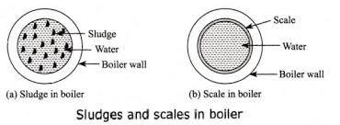
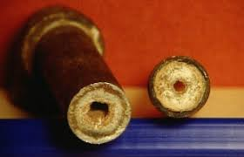
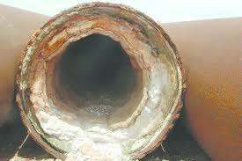
Sludge & Scale formation
In boilers, water evaporates continuously and concentration of dissolved salts increases.
When it reaches saturation point they will be precipitated on the inner walls of the boilers.
If the precipitation takes place in the form of loose and slimy, it is called sludge.
If the precipitation takes place in the form of hard, adhering on the inner walls of the boilers, it is called scale.

Slide 31
Difference between Sludges and Scales
Sludges | Scales
Sludges are soft loose and slimy precipitate. They are non-adherent deposits and can be easily removed. Formed by substances like CaCl₂ , MgCl₂ ,MgSO₄, MgCO₃ etc. Formed at comparatively colder portion of the boiler. They decrease the efficiency of boiler but are less dangerous. Can be removed by blow-down operation. | Scales are hard deposits. They sticks very firmly to the inner surface of boiler and are very difficult to remove. Formed by substance like CaSO₄, Mg(OH)₂ etc. Formed generally at heated portions of the boiler. Decrease the efficiency of boiler and chances of explosions are also there. Cannot be removed by blow-down operation.

Slide 32
SLUDGE:
It is formed at colder portions of the boilers.
It is formed by substances, which have greater solubility in hot water than cold water(MgCO₃,MgCl₂, MgSO₄, CaCl₂).
It can easily scrapped off with a wire brush.
Disadvantages:
Sludge's are poor conductors of heat.
Disturbs the working of boilers.
Prevention of Sludge Formation:
By using well-softened water.
By frequently blow-down operation(nothing but the removal concentrated water through an out let at the bottom of the boiler).

Slide 33
Scales: Scales may be formed inside the boiler due to:
A).Decomposition of Ca (HCO₃)₂:-In low pressure boilers CaCO3 causes scale formation, but high pressure boilers CaCO3 is soluble
Ca (HCO₃)₂ → CaCO₃↓ +H₂O +CO₂↑
CaCO₃ + H₂O → Ca(OH)₂ + CO₂↑
B). Deposits of CaSO₄:- The solubility of CaSO₄ decreases with increasing the temperature. So it is soluble in cold water and insoluble in hot water. Hence it get precipitated in hotter region.
C). Hydrolysis of MgCl₂:-
MgCl₂ + 2H₂O → Mg(OH)₂ ↓ + 2HCl
D). Presence of silica:- Even if small quantity of SiO₂ is present, it may deposits as CaSiO₃ (or) MgSiO₃. These deposits adhere very firmly on inner side of boiler surface.

Slide 34
Disadvantages of scale formation:
Wastage of fuel: Rate of heat transfer is greatly reduced due to poor conductivity of scales. Overheating is required for steady supply of heat hence fuel consumption increases.
Lowering of boiler safety: To supply steady heat overheating is required, which makes the boiler material weak &soft. Results in distortion of boiler tube.
Decrease in efficiency of boiler: Deposition of scales in valves and condensers choke them partially& decreases the efficiency of boiler
Danger of Explosion: Due to uneven expansion the thick scales gets cracked, results in formation of large steam & develops high pressure. It may cause explosion of boiler.
Removal of scales:
Mechanical/chemical method
Loosely adhering scales are removed with the help Scraper/wire brush
Brittle scales are removed by giving Thermal shocks
Loosely adhering scales are removed by frequent blow down operation

Slide 35
Treatment (or) Softening of water for industry
Water used for industrial purpose should be sufficiently pure.
The process of removing hardness producing salts from water is known as softening of water.
In industry, main methods employed for softening of water are two types.
Internal treatment or conditioning
External treatment or conditioning
Internal treatment:
The softening of water carried out inside the boiler is called internal treatment of water. In this process the hardness causing salts are removed
Sludge formation can be removed by blow down operation.
Scale formation can be prevented by internal treatment that involve addition of chemical to the boiler water either to precipitate or the scale forming impurities in the form of sludge.

Slide 36
Colloidal conditioning:
The scale formation in low pressure boilers can be prevented by the addition of kerosene, tannin, agar-agar etc.
which will be get coated over the scale forming precipitates.
These forms loose, non-sticky deposits (sludge) that can be removed by blow down.
This type of conditioning is called colloidal conditioning.
Phosphate conditioning:
In this process, the permanent hardness causing salts(Scale) in high pressure boilers will be removed by reacting with sodium phosphate.
The complex formed is soft, non-adherent and easily removable(Sludge).
3MCl₂ + 2Na₃PO₄ → M₃( PO₄)₂↓ + 6NaCl
[Where M = Ca²⁺, Mg²⁺]
3MSO₄ + 2Na₃PO₄ → M₃ ( PO₄)₂↓ + 6NaSO₄

Slide 37
Carbonate conditioning:
The hard and strong adherent scales formed due to CaSO₄ are avoided by the addition of sodium carbonate.
The CaSO₄ is converted to CaCO₃, which is loose sludge and it can be removed by blow down.
CaSO₄ + Na₂CO₃ → CaCO₃↓ + Na₂SO₄↓
Calgon conditioning:
Sodium hexameta phosphate Na₂[Na₄(PO₃)₆ or (NaPO₃)₆ is called calgon.
This forms soluble complex compounds with CaSO₄.
The treatment of boiler water with calgon is called calgon conditioning.
Na₂ [Na₄ (PO₃)₆] ↔ 2Na⁺ + [Na₄ (PO₃)₆]²⁻
Calgon
2CaSO₄ + [Na₄ (PO₃)₆]²⁻ → [Ca₂ (PO₃)₆]²⁻ + 2Na₂SO₄
Insoluble soluble insoluble

Slide 38
External treatment:
The treatment given to water for the removal of hardness causing salts before it is taken into the boiler is called ‘external treatment’.
Ion exchange, de-ionisation (or) de-mineralization process:
Ion exchange resins are insoluble, cross-linked, long chain organic polymers with a micro porous structure, and the ‘active sites’ attached to the chains are responsible for the ion exchange properties.
Resins containing acid groups (COOH, SO₃H) are capable of exchanging their H⁺ ions with other cations. This is called Cation exchange resin.
Ex: RCOOH, RSO₃H
Resins containing basic groups (OH⁻, NH₂⁻) are capable of exchanging their anions with other anions. This is called Anion exchange resin
Ex: R-CH₂NMe₂OH

Slide 39
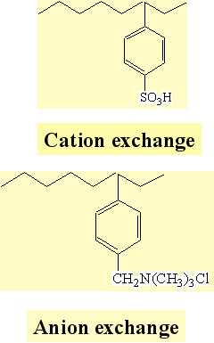
Process:
The hard water is passed first through Cation exchange column, which removes the cations like Ca²⁺ and Mg²⁺ etc from it, and equivalent amount of H⁺ ions are released from the column to water.
2RH + Ca⁺² → R₂Ca + 2H⁺
2RH + Mg⁺² → R₂Mg + 2H⁺
After Cation exchange column, the hard water is passed through anion exchange column, which removes all the anions like SO₄²⁻⁻, Cl ⁻, CO₂³⁻ etc. present in the water and equivalent amount of OH ions are replaced from this column to water.
ROH + Cl⁻ → RCl + OH⁻
2ROH + SO₄⁻² → R₂SO₄ + 2OH⁻
H+ and OH- ions (released from cation exchange and anion exchange columns respectively) get combined to produce water molecule.
H⁺ +OH⁻ → H₂O
OH

Slide 40
Regeneration :
Exhausted cation resin regenerated by dil. HCl , anion by dil.NaOH.
R₂Ca + 2 H⁺ → 2RH + Ca⁺² (washed)
R₂SO4 + 2OH⁻ → 2ROH⁻ + SO₄⁻²(washed)
Advantages:
The process can be used to soften highly acidic or alkaline waters;
It produces water of very low hardness, say 2ppm.
So it can be used in high pressure boilers.
Disadvantages:
The cost of equipment is relatively high and also more expensive chemicals (resins) are needed.
Fe, Mn – containing water and turbid water cannot be treated because Fe and Mn are irreversibly exchanged and turbidity reduces the efficiency of the process.

Slide 41
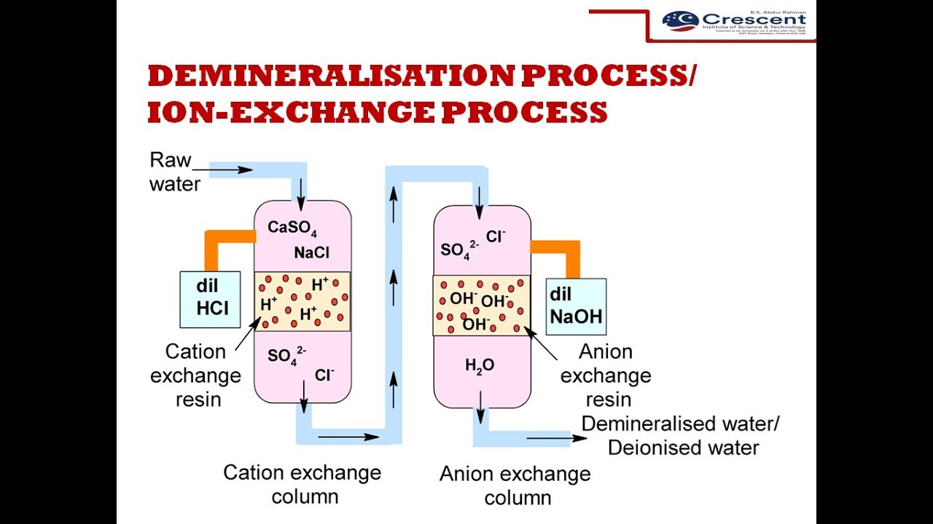

Slide 42
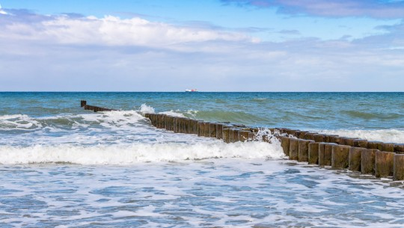
Desalination of brackish water
The process of removing common salt (sodium chloride) from water, is known as desalination.
The water containing dissolved salts with a peculiar salty (or brackish) taste, is called brackish water.
Sea water, containing on an average about 3.5% salts, comes under this category.
Brackish water is totally unfit for drinking purpose.
Commonly used methods for the desalination of brackish water is Reverse osmosis.

Slide 43
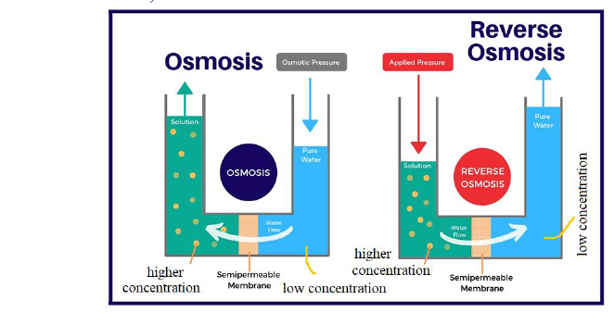
Reverse osmosis:
When two solutions of unequal concentrations are separated by a semi permeable membrane, flow of solvent takes place from dilute to concentrated sides, due to osmosis.
If, however, a hydrostatic pressure in excess of osmotic pressure is applied on the concentrated side, the solvent flow reverses.
That is solvent is forced to move from concentrated side to diluted side across the membrane. This is the principle of reverse osmosis.

Slide 44
Thus, in reverse osmosis method, pure solvent is separated from its contaminates, rather than removing contaminates from water.
This membrane filtration is sometimes also called super filtration or hyper-filtration
Advantages:
This process removes, ionic as well as non-ionic, colloidal and high molecular weight organic matter.
It removes colloidal silica, which is not removed by demineralization process.
The life time of membrane is quite high, about 2 years.
The membrane can be replaced within a few minutes, thereby providing nearly uninterrupted water supply.
Due to low cost, simplicity and high reliability, the reverse osmosis is gaining ground at present for converting sea water into drinking water.

Slide 45
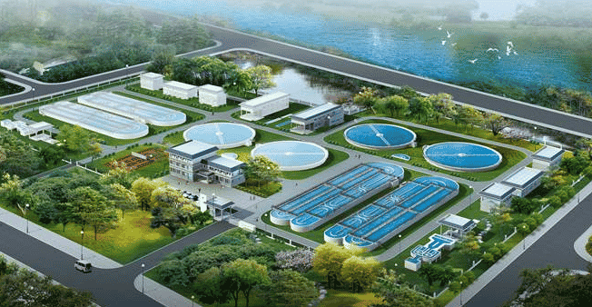
Specifications of potable or domestic water
The water supplied by municipality should be fit for human consumption.
It should satisfy the following requirements:
It should be colorless, odourless, and pleasant to taste.
Turbidity should not exceed 10 ppm.
TDS should not exceed 500 ppm.
It should not be very alkaline (pH 8.0).
It should be free from dissolved gases.(H₂S,CO₂)
It should be free from objectionable minerals such as Pb, As, Cs, Mn.
It should be free from pathogenic organism.

Slide 46
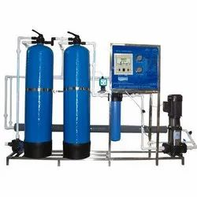
Portable water treatment
Treatment of water for drinking purposes mainly includes the removal of suspended impurities, colloidal impurities and harmful pathogenic bacteria.
The following stages are involved in purification
1. Screening
2. Sedimentation
3. Coagulation
4. Filtration
5. Disinfection
As required, other steps will be added, depending on the chemistry of the treated water.

Slide 47
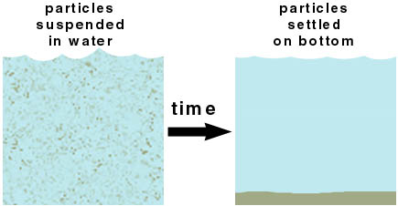
Screening
Screens remove large floating or suspended solids in the process of inflow. Materials like leaves, paper, twigs, and other debris are removed so as to avoid equipment or plant damage.
Aeration: The water is then subjected to aeration(reacting with air) which helps in exchange of gases between water and air, increases the oxygen content and removes the impurities like iron, manganese and dissolved gases like H₂S, CO₂ and NH₃
Sedimentation : The process of removing big sized suspended solid particles from water is called as plain sedimentation. In this process, water is stored in big tanks for several hours. 70% of solid particles settle down due to force of gravity.

Slide 48
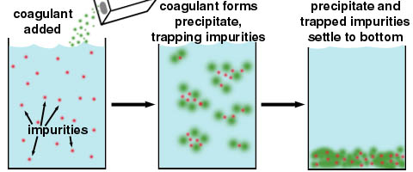
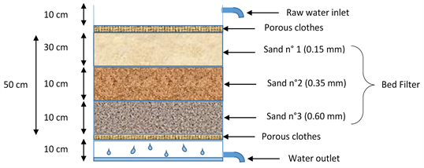
Coagulation : This is the process of removing fine suspended and colloidal impurities by adding coagulants like potassium alum (K₂SO₄Al₂(SO₄)₃ 24H₂O), Ferrous sulphate (FeSO₄), Sodium aluminate (NaAlO₂).
When coagulant is added to water, floc formation takes place due to hydroxide formation which can gather tiny particles together to form bigger particles and settle down quickly.
Filtration: The process of passing a liquid containing suspended impurities through a suitable porous material so as to effectively removed suspended impurities and some microorganisms is called filtration.
It is a mechanical process. When water flows through a filter bed, many suspended particles are unable to pass through the gaps and settle in the bed.

Slide 49
Disinfection or sterilization: The process of killing pathogenic bacteria and other microorganisms is called disinfection or sterilization. The chemicals used for killing bacteria are called disinfectants.
Boiling: Water is boiled for 10−15 min, where most of the pathogenic bacteria are killed.
By adding bleaching powder: Water is mixed with required amount of bleaching powder, and the mixture is allowed to stand for several hours
CaOCl₂ + H₂O → Ca(OH)₂ + Cl₂
Cl₂ + H₂O → HCl + HOCl
HOCl + Germs → germs are killed
The disinfection action of bleaching powder is due to available chlorine in it. It forms hypochlorous acid which acts as a powerful germicide (disinfectant).
Disadvantages:
Bleaching powder introduces Ca²⁺ hardness in water and adds lime residue.
Excess of it gives bad smell and bad taste.
Excess chlorine is irritating to mucous membrane.

Slide 50
Chlorination: The process of adding chlorine to water is called chlorination. Chlorine gas is a very good disinfectant, which can be bubbled in the water.
In this process calculated amount of chlorine gas is passed in order to destroy the pathogenic bacteria is called chlorination.
Chlorine is also reacts with water and generates hypochlorous acid and nascent oxygen, which acts a powerful oxidizing agent and kills the bacteria
Cl₂ + H₂O → HCl + HOCl
Bacteria + HOCl → killed bacteria
Advantages:
Storage requires less space
Effective and economical
Produce no salts
Ideal disinfectant
Disadvantages:
Excess of chlorine causes unpleasant taste and odour.
More effective at below p^{H} 6.5 and less effective at higher p^{H} values.

Slide 51
Break point chlorination (or) free residual chlorination :
It involves addition of sufficient amount of chlorine to oxidize:
Reducing substance
Organic matter
Free ammonia.
The reactions between chlorine and ammonia, metals and organic are easy to understand when the chlorine dosage and residual are plotted.
When chlorine is added to distilled water, the residual is equal to the dose. Because there is no chlorine demand.
From graph it is clear that in zone-1 chlorine added oxidizes reducing impurities of water. In zone-2 chlorine added forms chloramines and other chloro compounds.
In zone-3 chlorine added and chloramines causes destruction of bacteria. In zone-4 chlorine added is residual chlorine.
Break point is a point at which the chlorine demand has been totally satisfied. The chlorine has reacted with all reducing agents, organics, and ammonia in the water.
After this point, whatever chlorine is added breaks free from it and appears as a residual Cl₂ and hence this point is referred as break point dose.

Slide 52
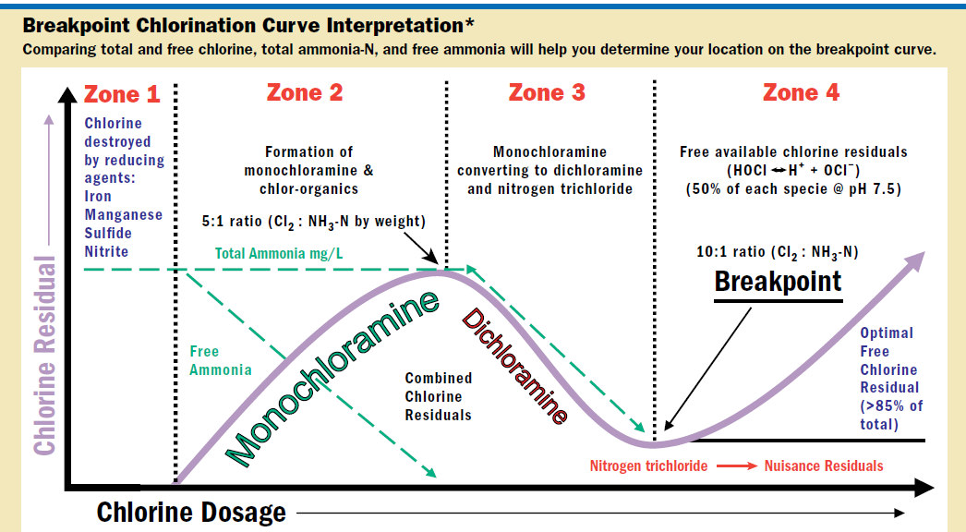

Slide 53
De-chlorination
Over chlorinated water can be de chlorinated by passing it through a bed of activated carbon. Excess chlorine can also be removed by adding SO₂ (or) Na₂SO₃.
SO₂ + Cl₂ + 2 H₂O → H₂SO₄ + 2HCl
Na₂SO₃ + Cl₂ + H₂O →Na₂SO₄ + 2HCl
By using chloramines (NH₂Cl): It is obtained by mixing chlorine and NH₃ in 2:1 ratio. It has better bactericidal action than chlorine. It is more stable and not producing any irritating odour.
NH₃ + Cl₂ → HCl + NH₂Cl
NH₂Cl+ H₂O → NH₃ + HOCl
Disinfection by ozone: Ozone is an excellent, disinfectant which can be prepared by passing silent electric discharge through pure and dry oxygen. Ozone is highly unstable and breaks down, liberating nascent oxygen. Nascent oxygen oxidizes organic matter in water and also kills bacteria
O₃→ O₂ + (O)

Slide 54
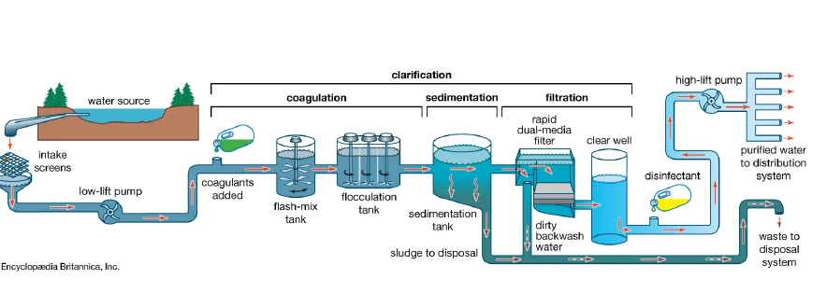

Slide 55
Short answer questions
List types of impurities in water.
Compare soft water with hard water.
Define brackish water and distilled water.
Write a note on carry over.
Differentiate Scales from Sludges.
What is desalination?
Write a not on reverse osmosis.
Define break point chlorination.
List specifications of portable water.
Define caustic embrittlement.
Compare temporary hardness with permanent hardness.
Write principle in EDTA method.
What is priming and foaming.
Define disinfection and give examples.
What are coagulants and give examples.
Write a note on ozonization .
List salts causing temporary and permanent hardness.

Slide 56
Long answer questions
What is hardness? Explain different types of hardness with units.
Elaborate ion exchange process with neat diagram and write limitations.
Explain various stages in the portable water treatment.
Describe the desalination of brackish water by Reverse Osmosis. Mention its advantages.
Illustrate caustic embrittlement and boiler corrosion.
Differentiate scales from sludges.
What is chlorination? Discuss break point chlorination.
Write a detailed notes scales and sludges.
Discuss internal water treatment.

